Slide 1
Hualapai START: Review of activities leading up to, during and after the Strategic Technical Assistance Response Team workshop from October 2012
Prepared for the Tribal Solar Working Group Meeting
March 24-25, 2015
Richard Knott and Kevin Davidson
Hualapai Planning and Economic Development Department

Slide 3
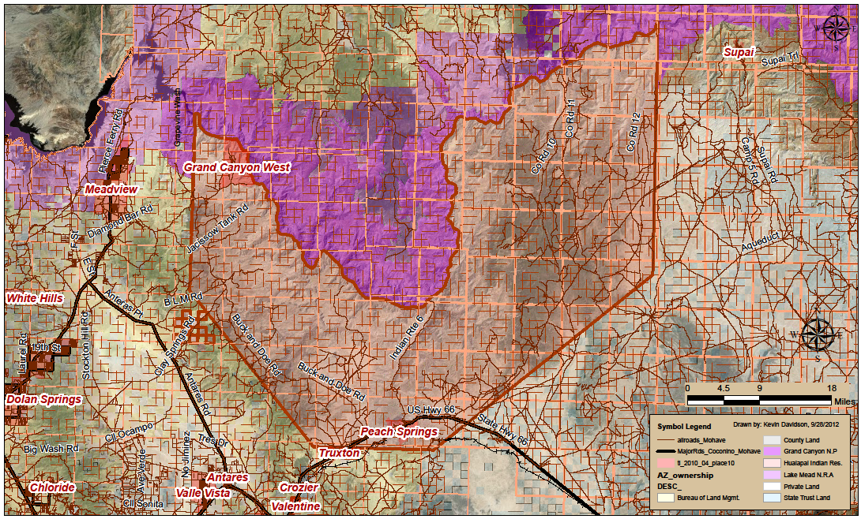
Map of Hualapai Reservation showing place names and locations of various studies
Blue Mountain
Clay Springs
Nelson

Slide 4
Current Environment (selected from START)
• 1.0 million acres, 108 miles of river front, 1,335 people on Reservation
New Head Start, Boys & Girls Club, Health Dept and Day Care buildings
• Skywalk & Grand Canyon West development have grown Tribe’s economy
Tribal government employees = 350 in 15 departments
Tribal Council supportive of new community projects
Own language & culture
60% + adult population ages 30+ have Type II diabetes
• Overweight youth, young and old adults
• Our young people don’t grow old. (alcohol/drugs) under 40 years old.
• A number of individuals (40-60 yr.) going to rehab in Flagstaff & Phoenix
• Most tribal members contribute to social security but don’t live to receive it, Life expectancy = 60+
• Population exodus and reduced tribal member blood quantum
• Income = $30,000yr/household
• 32% unemployment rate

Slide 5
Pre-START List of Grants for Renewable Energy Development
2002 – DOE - Native American Anemometer Loan Program - 20-meter MET Tower at radio tower site
2003 – BIA - Energy and Mineral Development Program - Renewable Energy Feasibility Study- Phase 1 MET Towers
2004 - RUS- High Energy Cost Rural Communities Program - GCW- Solar Power Construction Project
2005 – DOE - TEP - Tribal Utility Feasibility Study
2006 – BIA – EMDP - Biomass Feasibility Study
2007 - BIA – EDMP - Wind Energy Feasibility Study
2009 – DOE – TEP - Wind Energy Development Feasibility Study
2009 – DOE - EECBG - Juvenile Detention Center Solar System and Planning Office Energy Efficiency Improvements
2010 – BIA – EMDP - Solar Development Feasibility Study
2011 - MEC – School Solar Program for PV array at Peach Springs Elementary School

Slide 6
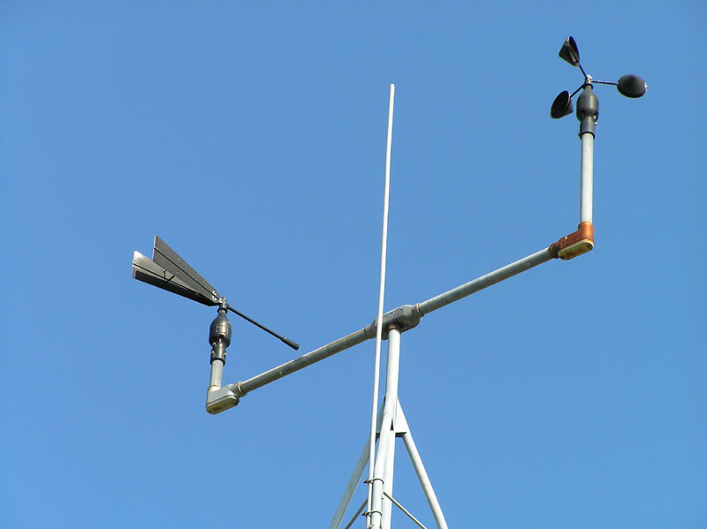
2002 - DOE- Native American Anemometer Loan Program
Project: Install one 20-meter meteorological tower located at Radio site in Peach Springs for a Community Wind Power Project of 2MW.
Findings: Class 3 wind regime suitable for utility scale wind turbines. However, development will be limited to small-scale machines due to community’s sensitivity to large wind turbines close to the town.
Status: No wind turbines constructed.

Slide 7
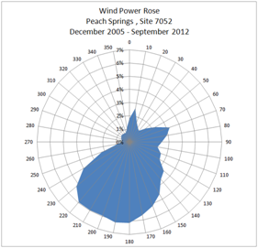
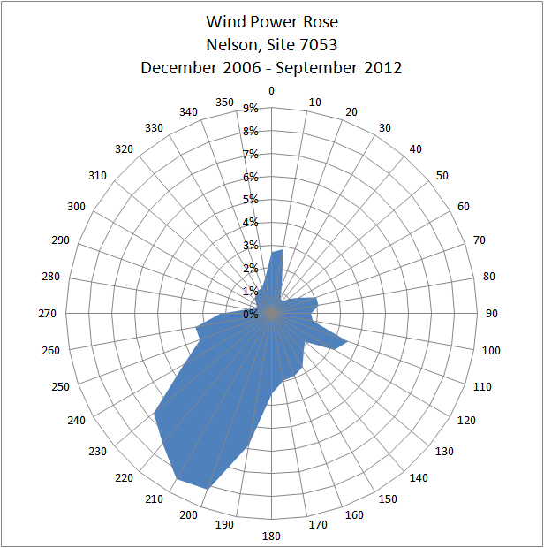
2003- BIA- Energy and Mineral Development Program
Proposal: Renewable Energy Feasibility Study - Phase I consisted of four 50-meter MET towers at:
Peach Springs - Community Power of 2 to 5 MW
Blue Mountain - Wind Farm of 5 to 10 MW
Grand Canyon West – Integration of wind for Solar Hybrid system
Nelson – Community-scale Wind Farm up to 5 MW and commercial-scale wind farm up to 10 MW.
Findings:
Peach Springs Site limited to small wind turbines (see above)
Blue Mountain site eliminated due to proximity of Tribal Cultural Resources
The Nelson site has excellent potential due to its close proximity to the Nelson Substation, however, the wind potential at that location is marginal for utility scale development.
The Grand Canyon West site emerged as the best candidate site for a large-scale wind farm
Status: No wind turbines constructed. Data collection from the Grand Canyon West tower has just ceased and will be used for 2009 DOE grant funded wind study. MET towers decommissioned in 2013.

Slide 8
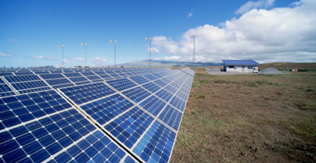
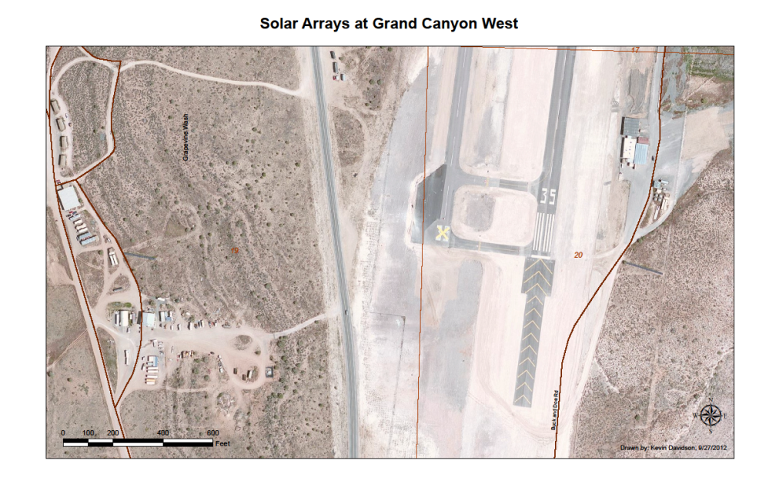
2004 – Rural Utility Service - High Energy Cost Rural Communities Program – Grand Canyon West - Solar Power Construction Project
Proposal: $2 Million Grant to fund
Solar Hybrid Power Plant consisting of 34 kW solar array and diesel generator backup
100 kW battery charging system to reduce diesel generator use.
Status: Solar array under repair. Battery maintenance practice needs to be improved to make system reliable.
17 kW array at Shop
17 kW array at Airport

Slide 9
2005 – DOE – Tribal Energy Program - Tribal Utility Feasibility Study
Situation:
Mohave Electric serves Hualapai Reservation (mainly along Route 66)
75-mile Power line to Havasupai abandoned to BIA
No Power at Grand Canyon West, load 500kW+ and growing
No Power to most of Reservation
Colorado River Storage Project Allocation Sold to Navajo Tribal Utility Auth
Electric Load in Peach Springs at approx 1 MW
Renewable energy resources are available to develop and sale
Feasibility Study for:
Tribal utility to operate power system at Grand Canyon West
Tribal take-over of MEC utility system on Reservation
Status:
Final Draft Report prepared on September 25, 2007.
Report resurrected in 2013 as part new effort to create Tribal Utility Authority.

Slide 10
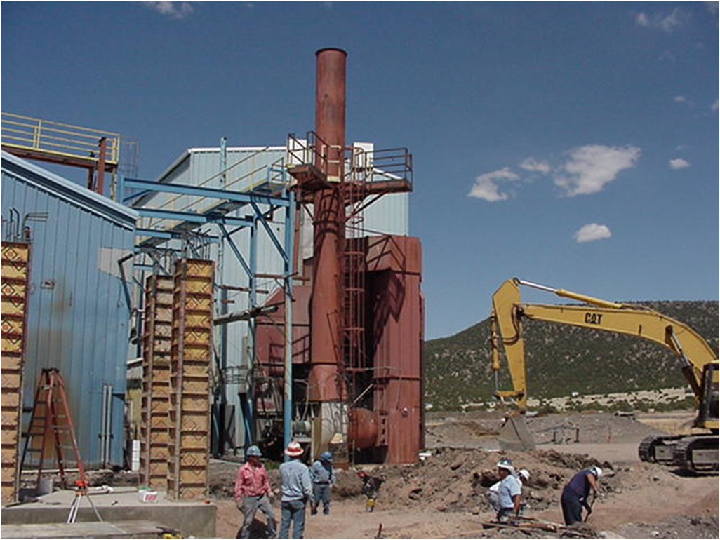
2006 – BIA – Energy and Mineral Development Program - Biomass Feasibility Study
Proposal: Reservation-wide assessment of Hualapai renewable energy resources including wind, solar, and biomass.
Outcome: Wood to energy not economically viable at this time. The study also looked into markets for other forest based products such as building materials and found only very limited and specialized markets for such products in the region.
Status: Inactive; however, a British Columbia wood pellet making company looking to expand its business into the US market has shown in the Southwest.
Stone Forest Products sawmill repowering project in Eagar 3MW Initially - 21,000 MWh per year
Wood pellet stove

Slide 11
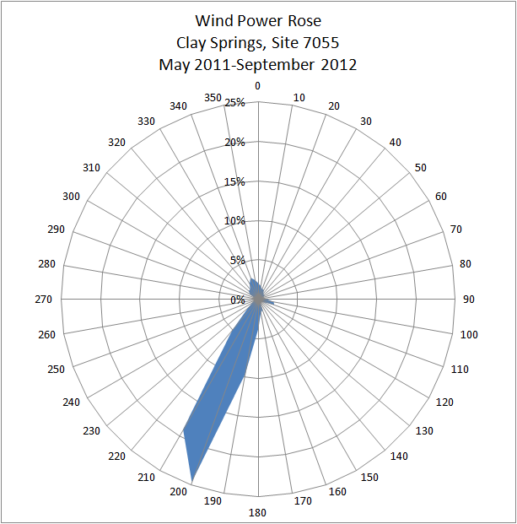
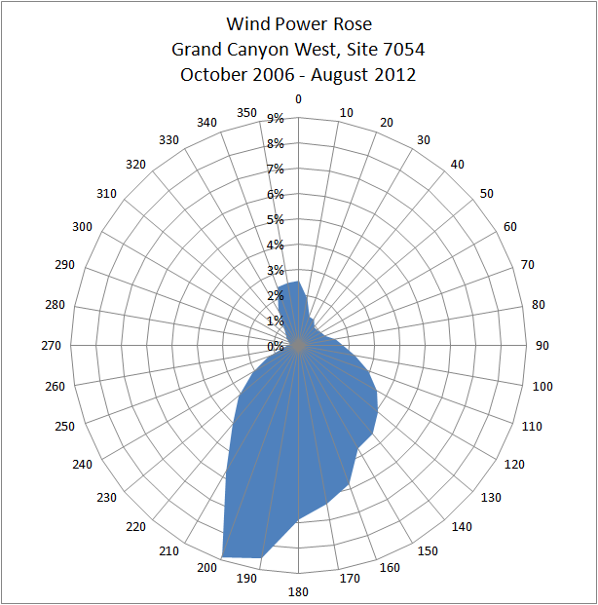
2007 - BIA – Energy and Mineral Development Program - Wind Energy Feasibility Study
Proposal: Extension of Reservation-wide assessment of Hualapai renewable energy resources to focus on wind energy development.
Outcome: Wind energy project areas expanded to Clay Springs and refined according to wind resource, transmission availability and environmental considerations.
Status: Data collection from towers has ceased and will be used for 2009 DOE grant funded wind study. Met towers decommissioned in 2013.

Slide 12
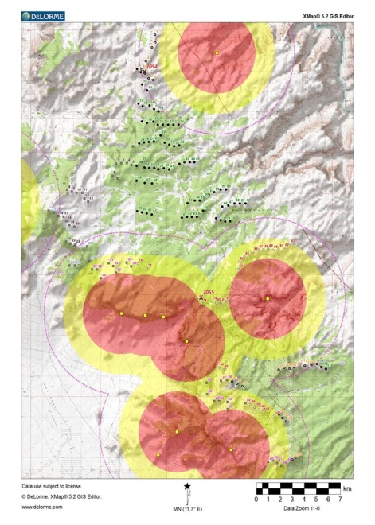
2009 – DOE – TEP - Wind Energy Development Feasibility Study
Proposal: $742,494 allotted to advance the development of the Hualapai’s wind energy resources from the initial assessment and feasibility study phase to the business plan development phase which will allow the implementation of construction activities as soon as a power purchase agreement has been secured between the project developer and a buyer of the electricity.
Progress to date:
Interconnect application filed w/ Western Area Power Admin
Critical Issues Analysis
Avian Use Study
Fall Raptor Migration Study
Turbine array planning
Solicitation of wind developers, in progress
Final Report to include above reports which was presented to DOE on November 16, 2012, in Denver.
Final Report presented to Council in January 2013.
Status:
Grant closed June 30, 2013
Wind farm development deferred to future Council decision

Slide 13
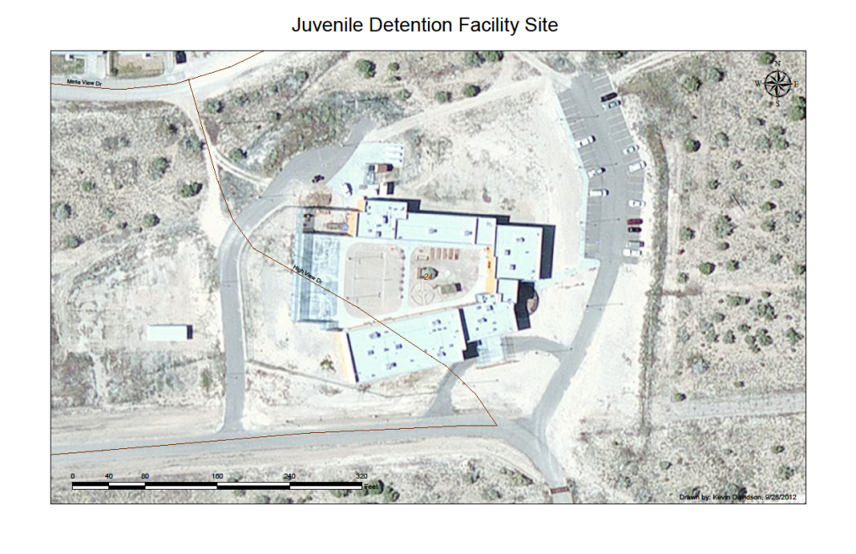
2009 – DOE - EECBG - Juvenile Detention Center Solar System and Planning Office Energy Efficiency Improvements
Proposal: $114,670 to Increase energy efficiency of tribal office buildings and install solar array at Juvenile Detention Facility.
Outcome: a 10kW solar PV array was installed at the new Juvenile Detention Center in 2011. Monies were also spent on installing solar tube skylights, better insulation and exterior windows at Tribal offices, and a more efficient water heater and AC unit at the Planning Dept
Status: Operational.

Slide 14
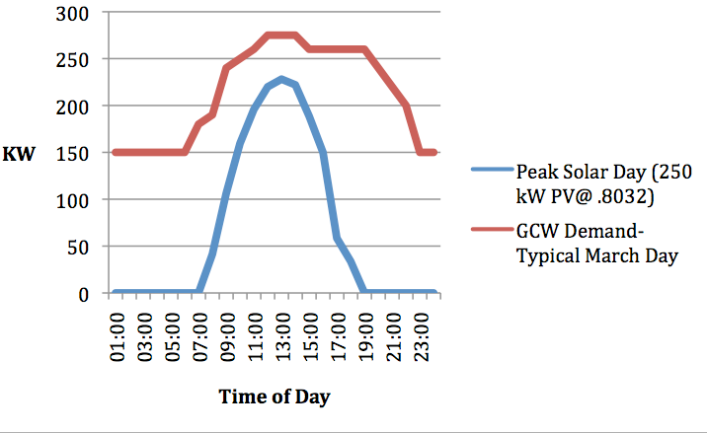
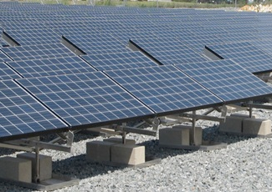
2010 - BIA Energy and Mineral Development Program- Solar Development Feasibility Study
Proposal: $276,605 to advance the development of the Hualapai’s solar energy resources from the initial assessment/feasibility phase to the business plan development and power purchase agreement which will allow for construction.
Progress to Date: Preliminary Solar Feasibility Report prepared Peach Springs/Nelson, Clay Springs and Grand Canyon West
GCW Option 1: 250 kW solar array without storage to address peak demand
GCW Option 2: 500 kW solar array to charge batteries & supply off peak use.
Status:
Grant closeout September 2013
GCW and Clay Springs sites on hold
Peach Springs/Nelson sites in review by HTUA

Slide 15
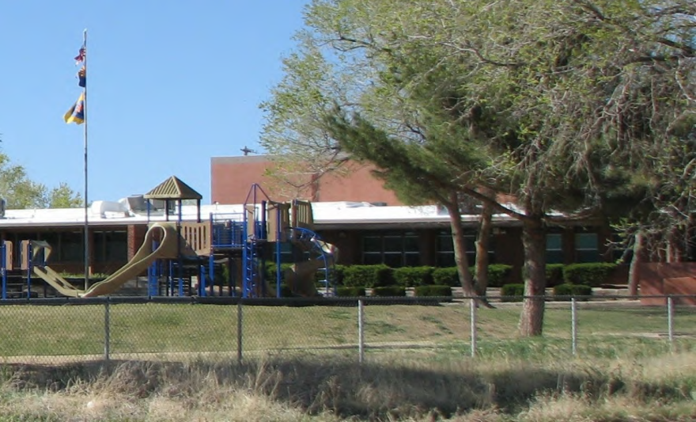
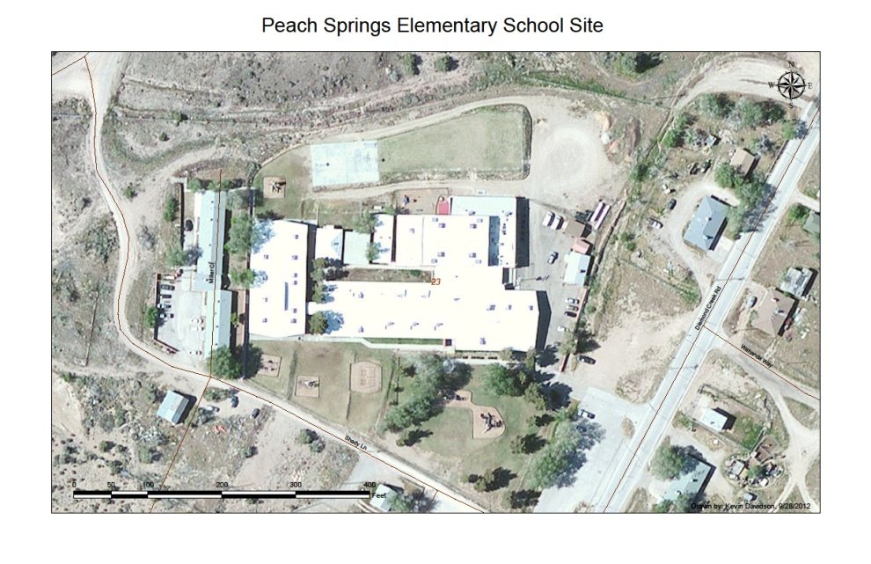
2011 - MEC – School Solar Program - PV array at Peach Springs Elementary School
Project: As part of the Renewable Energy Standard Tariff (REST), Mohave Electric Cooperative (MEC) set a goal of allocating $50,000 to every public school in its service territory for the installation of a solar energy system. The Grand Canyon Trust will also contribute $30,000 to build the solar array.
19kW array should offset 10 - 12% of the school’s annual electrical costs
Status: Operational on 6/19/2013

Slide 16
Review of START Planning Session of 2012
Applying for START Application submitted by Hualapai in January 2012 and awarded in June 2012 to provide updated resource assessment analysis and project feasibility analysis, with primary focus on a renewable energy project to help power the Tribe’s Grand Canyon West development.
What does START do? The START Program seeks to spur clean energy project development by providing Tribes with tools and resources needed to foster energy self-sufficiency, sustainability, and economic competitiveness. With the support of technical experts from the National Renewable Energy Laboratory (NREL), START assists tribal leadership with project development and financing and helps tribal communities strategically plan their energy future.

Slide 17
START - Practical Vision Workshop, part 1
1. Towards: Safe & Socially Responsible Energy Use & Management in Daily Life for 2022
a. All Hualapai Have Access to Affordable or Free Transportation
b. Sustainable Economic Security
c. Protection of Environment Through Sustainable Clean Energy
2. Towards: Mental, Physical, Spiritual Health & Well Being For Community, Family & Individual in 2022
a. Assuring Healthy Food Availability For Community Well-Being
b. Local Access to Variety of Education Options
c. Safe, Compassionate Resources to Care For Our Elderly Treasures

Slide 18
START - Practical Vision Workshop, part 2
3. Towards: Healthy, Viable Economic Community Through Individual Independence by 2022
a. Deeper Connecting Harmony & Accountability Between Government & the People
b. Energy Independence Through Utility Ownership
c. Well Balanced Hualapai Living Happy & Healthy Lifestyles
d. Thriving Cultural Identity & Education Woven Into Daily Life

Slide 19
START - Practical Vision Workshop, Brainstorming for Safe & Socially Responsible Energy Use & Management in Daily Life
Clean Energy
• Straw Bale Home & Building Construction With Solar & Wind Energy
• New Energy Source
• Solar Over Wind – Structural (Aesthetics)
• Savings in Home Energy Expense
• Tribal Wide Adaptive Strategies to Climate Change
• Solar Panels: Street Lights, Homes
Access to Affordable Transportation
Motor Pool With Fuel and Transit Station and Mechanic
Metro-Link (Train) to Kingman, Flagstaff
Tribal Owned Gas Station with Car Wash – Revenue for Tribe
Tribal Mini-Bus Transit throughout Peach Springs Community

Slide 20
START - Practical Vision Workshop, Brainstorming for Safe & Socially Responsible Energy Use & Management in Daily Life
Energy Independence
• Utility Authority, Local Power Access, Local Billing
• Power is Power - We Control Our Destiny
• Having Our Own Utility Empowers Our Community With More Jobs: Local Opportunity
• GCW is Solar/Wind Powered, Peach Springs is Solar Powered
• Cost Saving to Our Community by Providing Local Service
• Power to Tribal Members Homes (more & larger)-Better Industry & Economy
• Colorado River Water Right in Place

Slide 21
START - Underlying Contradictions Workshop What are the issues and obstacles which block progress towards our shared energy vision?
FEAR OF FAILURE FUELS JEALOUSY SEPARATION & COMPETITION
DISJOINTED & UNDERDEVELOPED COMMUNICATION SKILLS INHIBIT UNDERSTANDING BETWEEN INDIVIDUALS & COMMUNITY
EDUCATION & TRAINING OPPORTUNITIES NOT LOCALLY VALUED OR AVAILABLE
REMOTE LOCATION MAKES TRANSPORTATION ISSUES MORE CRITICAL

Slide 22
START – Strategic Directions Workshop for 2014
DIVERSIFYING DEVELOPMENT OPPORTUNITIES TO NURTURE LEARNING, GROWTH & ACHIEVEMENT = MORE CHOICES FOR HUALAPAIS!
Establish & Implement Longer Hours For Education Center For Adult Workers & Head Start Student After Hour Access
Educate Adults
Distributed Wind & Solar Interconnection Workshops
Adult/Youth Nurturing
Develop & Design a Plan For a Training Class Focusing on Wind & Renewable
Develop a Teaching Plan to Educate the Public/Community on Energy Technology
Educate the Community For Readiness
Implement Better Access to On-Line Classes & Tutoring
Diversify & Expand access to Career & Education Counseling Locally

Slide 23
START – Strategic Directions Workshop for 2014
DEVELOPING COMMUNITY AWARENESS & PARTICIPATION IN RESPONSIBLE ENERGY OPPORTUNITIES = ALL HUALAPAIS HAVE A STAKE IN THE GAME!
Create a Tribal Energy Committee: Energy Education, Searching For Sites
Prioritize Peach Springs Power Supply Over GCW
Develop a Tribal Utility Authority to Spearhead/Guide Development of Energy Infrastructure
Award Water Rights Settlements Revenue to Tribe for congressional funding that builds the infrastructure to deliver the water to Tribe: Better Services to Community, Education, Language Cultural Preservation
Build electric distribution grid at Grand Canyon West
Develop a Roof-Based Generation Program to Help Reduce Resident’s Cost For Power
Select Site For Solar Array to Serve Peach Springs
Establish a Hualapai Tribal Utility Cooperative/Authority
Design Cultural Landscape Map Showing Proposed Energy Projects For Community Viewing

Slide 24
START – Strategic Directions Workshop for 2014
COMMUNICATING EASILY DIGESTIBLE INFORMATION WITH A PROCESS TO REPLY & RETORT = ALL HUALAPAIS GET INVOLVED!
Provide Technical & Financial Analysis Assistance For Commercial-Scale Renewable Development Projects
Community Outreach with This Plan
Map Showing Flow of Electron’s Money To and From the Hualapai Tribe, Showing Benefit to Community
Discuss & Secure Informed Consent On-Site location (of renewable energy projects) & the Benefits to the Community
Develop Information Flyers to Inform the Community About the START Program and the Results of These Meetings Emphasizing Project results & Benefits
Positive Information in Gamyu (newsletter) and EPCH (radio station)
Develop a Community Strategy That Incorporates All Media/Information Outlets
Listening to Individual Barriers & Needs & Not Being Judgmental
Make Information Available on Facebook
Provide Updated Resource assessment Analysis & Project Feasibility Analysis With Primary Focus on a Renewable Energy Project to Help Power The Tribe’s Grand Canyon West Development

Slide 25
START – Strategic Directions Workshop for 2014
COORDINATING MULTI-AGENCY EFFORT TO ESTABLISH TRANSIT SYSTEM = HUALAPAIS ON THE MOVE!
Implement a Mini-Van Route Serving Peach Springs
Develop a Mechanic/Auto Shop
Avoid Fuel Cost Increases
Establish a Tribal Transit System to Serve Local Transportation Needs

Slide 26
Post-START Grants referencing Strategic Energy Launch Plan
2013 – ADOT – Planning Assistance for Rural Areas (PARA) for Hualapai’s Long Range Transportation Plan.
2014 – ADOT – Transit Feasibility Study for Hualapai Tribe
2014 – BIA – Indian Energy and Economic Development (IEED) for Tribal Energy Development and Capacity Building for management training and apprenticeship program
2014 – USDA/Rural Utilities Service - High Energy Cost Rural Communities Program - Power Line Construction along Diamond Bar Road to Grand Canyon West (in review by USDA)
Projects after START
Adopted Strategic Energy Launch Plan in November 2012
Launched remodel of existing market with addition of tribally-owned fuel station in July 2014 (estimated completion date in early May)
Established Hualapai Utility Authority in September 2014

Slide 27
2013 – ADOT – Planning Assistance for Rural Areas (PARA) for Hualapai’s Long Range Transportation Plan
Proposal: Planning Assistance for Rural Areas (PARA) for Hualapai’s Long Range Transportation Plan. Plan includes roadway inventory, suggestions for transportation system improvements, including transit a system and network of walking trails
Progress to Date:
Award to Jacobs Engineering in Summer of 2013
Plan Adopted by Tribal Council in December 2014

Slide 28
2014 – ADOT – Transit Feasibility Study for Hualapai Tribe
Proposal: ADOT “5311” grant in conjunction with existing FTA grant for transit feasibility study to develop a transit plan for the Tribe which may include a shuttle bus service serving greater Peach Springs and Grand Canyon West.
Progress to Date:
Award Summer of 2014
Negotiating contract with transit consultant Kimley-Horn

Slide 29
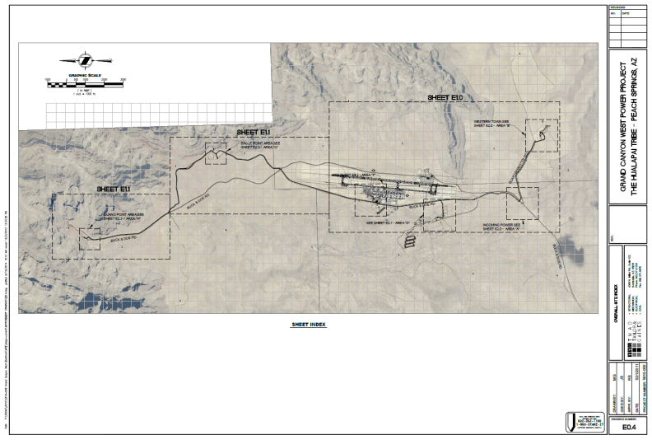
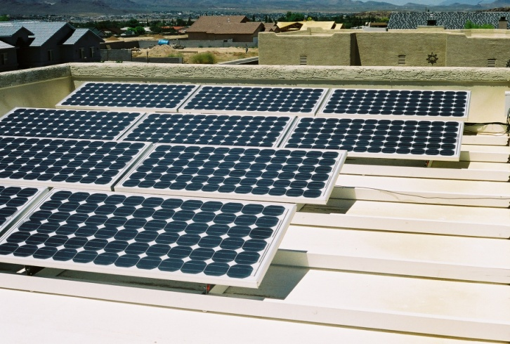
2014 – BIA - IEED – Tribal Energy Development Capacity Grant
Proposal: $100,300 allotted to:
Establish training a program for GCRC staff to operate the mini-grid and GCW and begin an electrical apprenticeship program for solar PV installation on the Reservation.
Provide training to Hualapai to negotiate power line rights-of-way leases
Implement a Tribal Utility Authority
Hire a renewable energy expert to seek a buyer of solar power produced on the Reservation.
Prepare a energy capacity assessment report.
Progress to date:
Award announced in May 2014
RFPs advertised

Slide 30
2014 – USDA/Rural Utilities Service - High Energy Cost Rural Communities Program
Proposal: $1,881,130 request to:
Construct 20.8 KV 20-mile power line along Diamond Bar Road to connect the Grand Canyon West micro-grid to the regional electric grid.
Grant to pay for the prorated share of residential electrical demand at Grand Canyon West (≈16% of project cost).
Grant to be coupled with a USDA loan to pay for the commercial electrical demand at Grand Canyon West.
Will establish Hualapai Tribal Utility Authority to be the wholesale customer and to set retail electrical rates sufficient to cover operations and pay back loan to USDA
Progress to date:
Applied for grant in August 2014
Established HTUA in September 2014
Award announcements expected in May 2015

Slide 31
Questions and Comments
Thank You!
Hualapai Planning and Economic Development Department
887 West Hwy 66, Peach Springs, Arizona
(928) 769-1310
Kevin A. Davidson Director Richard Knott, Grant Writer
kdavidson@hualapai-nsn.gov rknott@hualapai-nsn.gov

