Slide 1
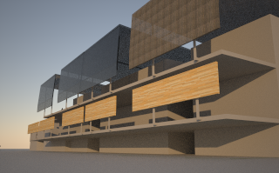
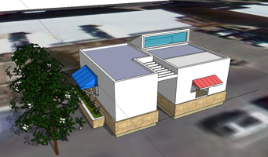
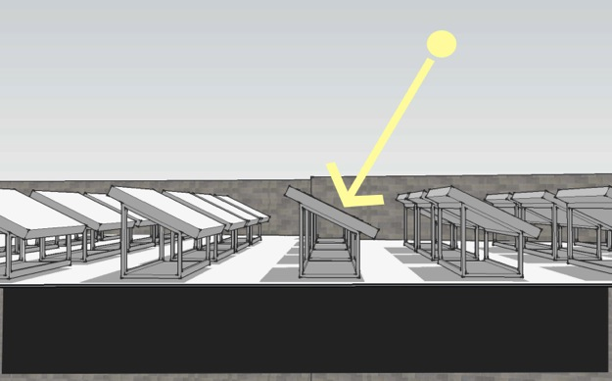
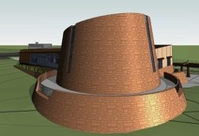
s u s t a i n a b l e . h o u s i n g
best practices : the right tools for the times
cliff . johns
college of architecture and
landscape architecture
energy design conservation
June 23, 2015

Slide 2
s u s t a i n a b l e . h o u s i n g

Slide 3
sustainability

Slide 4
“…our buildings need to be
sustainable”

Slide 5
“…our buildings needs to have
g r a v i t y”

Slide 6
sustainability has always been among indigenous nations

Slide 7
respect for our natural environment

Slide 8
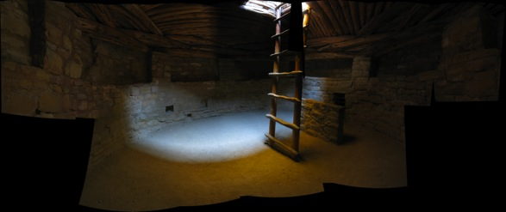

natural law

Slide 9
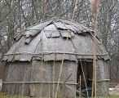
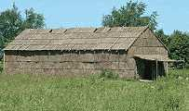
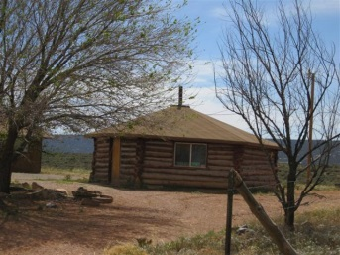
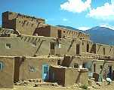
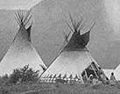
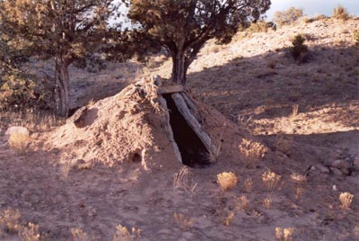
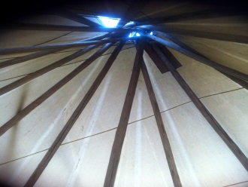
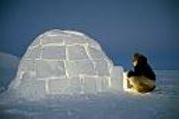
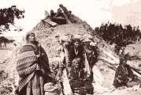
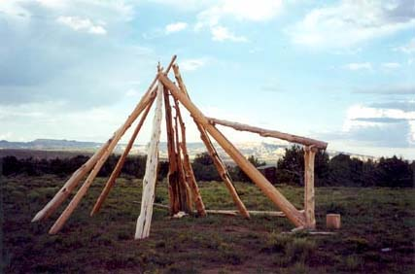
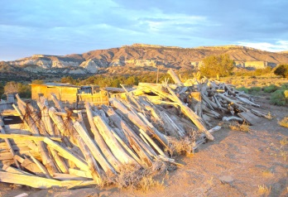
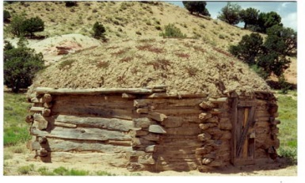
Indigenous
Architecture
Notes:
The intent when considering tribal housing design and planning

Slide 10
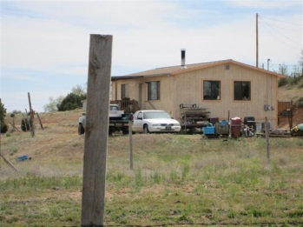
Today . . .
Notes:
Yet we still follow the same rout

Slide 11

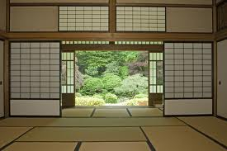
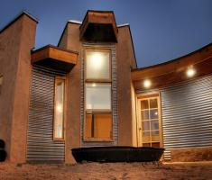
Natural Law
Fengi Shui
(Eastern Philosophy)
Diné Epistemology
(Dine’ Natural Law
Wood
Fire
Earth
Metal
Water
Earth
Fire
Air
Water
11
Notes:
Fung - Shway

Slide 12
o v e r v i e w
the focus
our impact
tribal housing
tools
sustainable design practices
building retrofits
HED

Slide 13
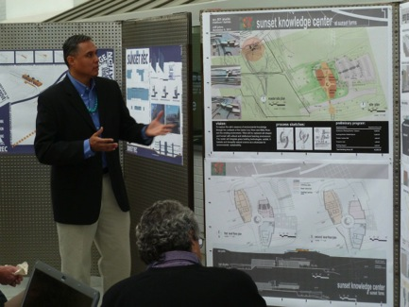

introduction
Why sustainable energy design approach?
Addressing issues of climate and microclimate designs
Reducing CO₂ Gas Emissions
Appropriating better material & methods
Passive solar design
Achieving human thermal comfort

Slide 14
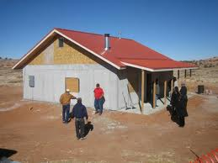
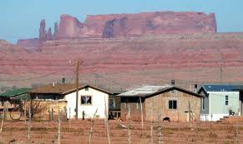
current conditions
the focus
Tribal Housing – Navajo Nation
Poor conditions
Building materials deterioration
Unbalanced HVAC systems
Poor constructability = poor building performance

Slide 15
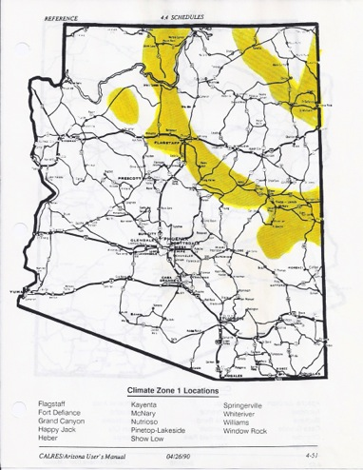

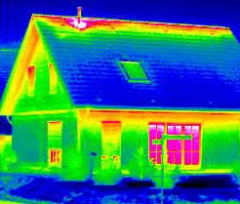
tribal housing
the focus
Climate zone 1
Typical Tribal Housing Standards
Federal Standards:
R-30 = ceilings
R-15 = walls
Design Climate Zone Standards:
R-38 = ceilings
R-20 = walls
(Times photo - Paul Natonabah)

Slide 16
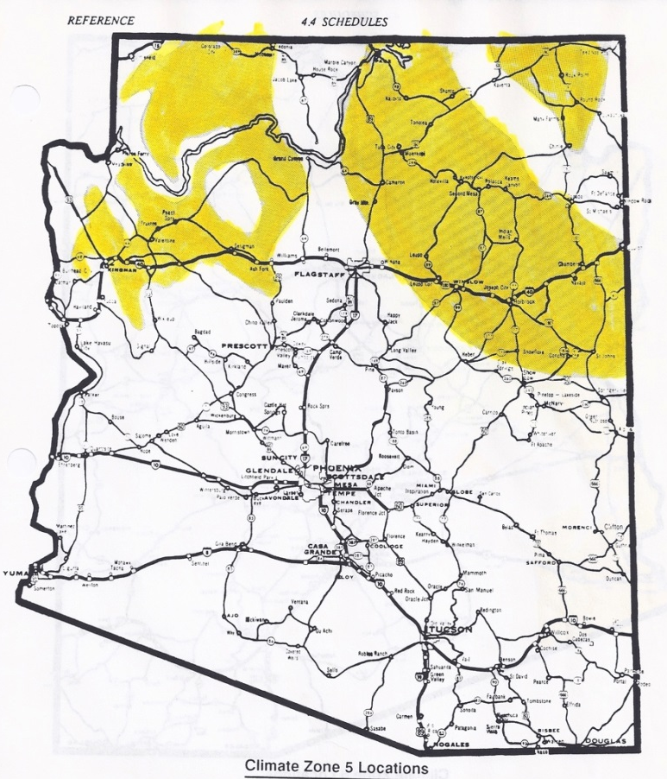
Problem Statement
Climatic Zone: 5
Location: Winslow, AZ
Unit SF: 1,620 SF

Slide 17
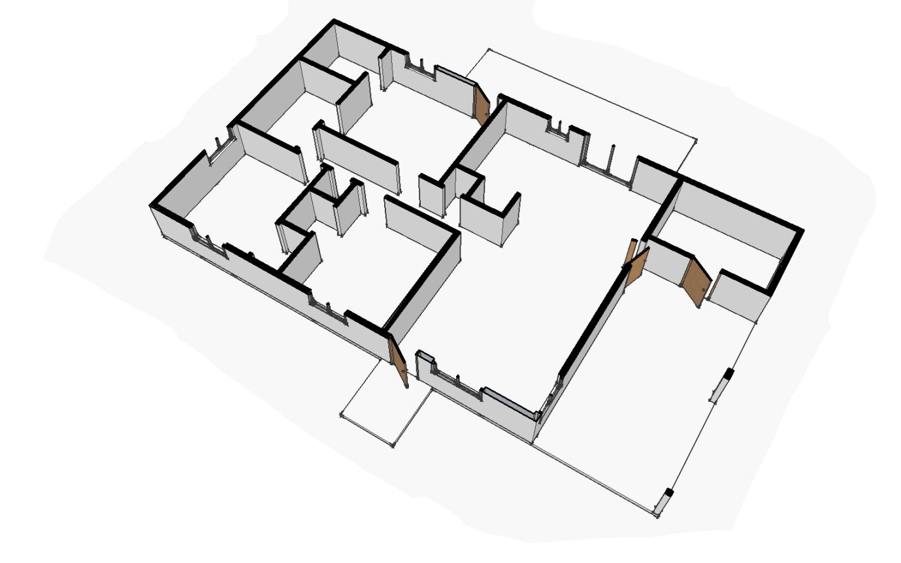
Tribal Housing
Problems:
Small Kitchen
Small Bedrooms
Overcrowding
Small Dining Area
Patio
Bath
BR 3
Kitchen
BR 2
Dining
Sto
BR 1
Living
Carport
Entry
Model Rendering: By Cliff Johns

Slide 18
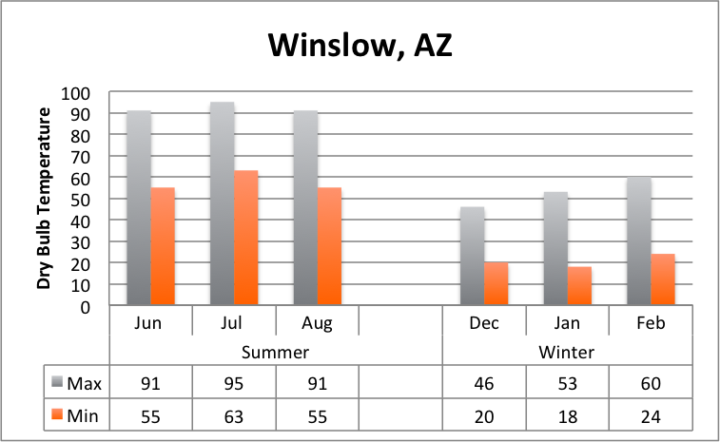
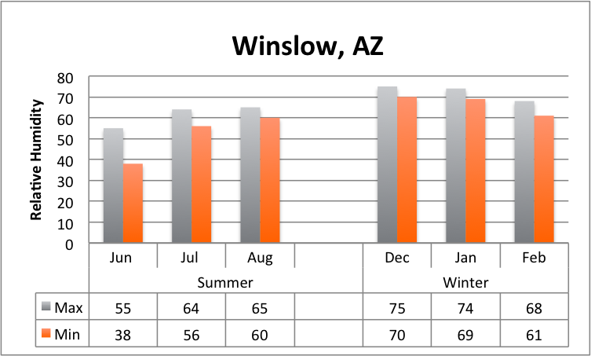
Psychrometric Chart
Climate Region: Wiinslow, AZ
 |  | Dry Bulb Temperature
 |  | Max | Min
Summer | Jun | 91 | 55
 | Jul | 95 | 63
 | Aug | 91 | 55
Winter | Dec | 46 | 20
 | Jan | 53 | 18
 | Feb | 60 | 24
 |  | Relative Humidty
 |  | Max | Min
Summer | Jun | 55 | 38
 | Jul | 64 | 56
 | Aug | 65 | 60
Winter | Dec | 75 | 70
 | Jan | 74 | 69
 | Feb | 68 | 61
Notes:
Quick table of contents outlining my discussions

Slide 19
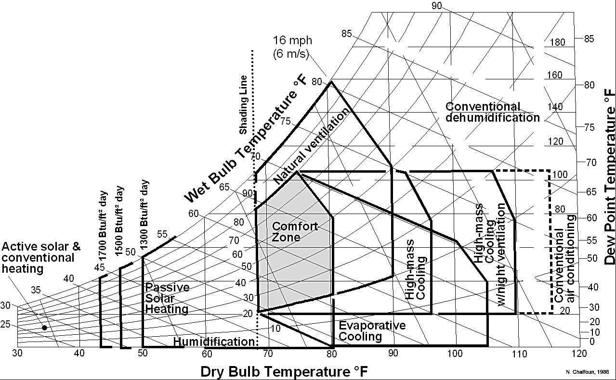
Psychrometric Chart
Design Strategies:
Passive Solar Heating
High Mass Cooling
High mass Cooling w/
Ventilation
Natural Ventilation
Evaporative Cooling
Summer Months:
June
July
August
Notes:
Quick table of contents outlining my discussions

Slide 20
Psychrometric Chart
Design Strategies:
Active Solar
Conventional heating
Passive Solar Heating
Humidification
Winter Months:
December
January
February
Notes:
Quick table of contents outlining my discussions

Slide 21
Energy-10 Code Analysis

Slide 22
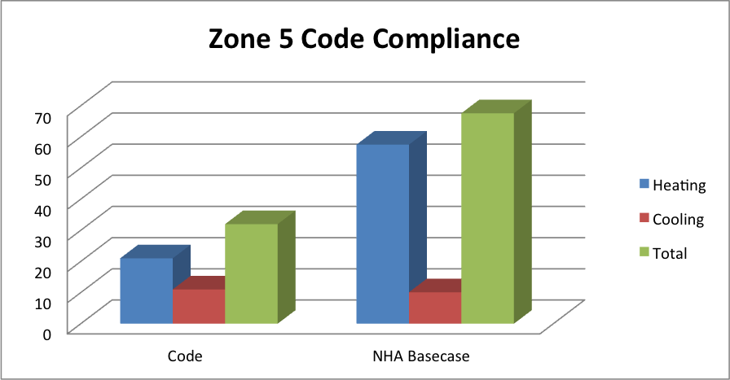
Energy Code Analysis

Slide 23
tools
sustainable design practices
building retrofits
HED

Slide 24
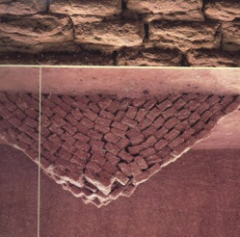
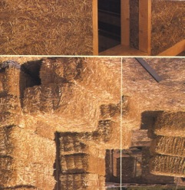
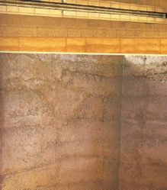
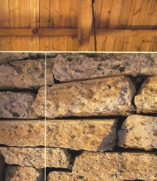
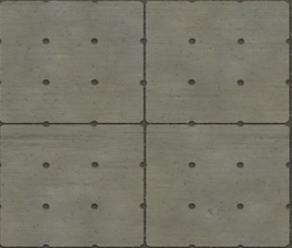
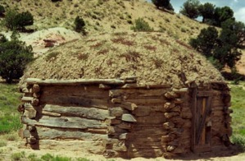
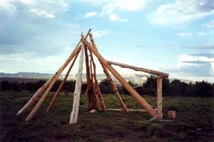
sustainable design practices
materials & methods
Photo: Richard K. Begay
Photo: Richard K. Begay
Courtesy: Benally House 2007- DesignBuildBLUFF
technical

Slide 25
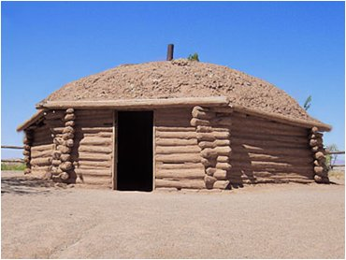
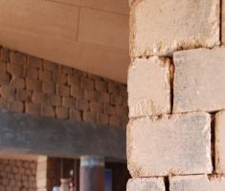
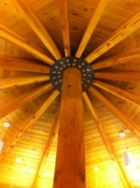
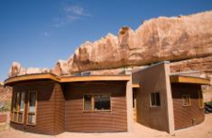

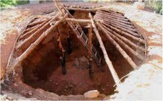

sustainable design practices
indigenous architecture & materials

Slide 26
energy design strategies
thermal mass
building orientation
passive solar
shading
natural ventilation

Slide 27
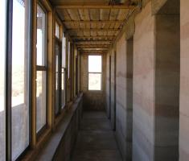
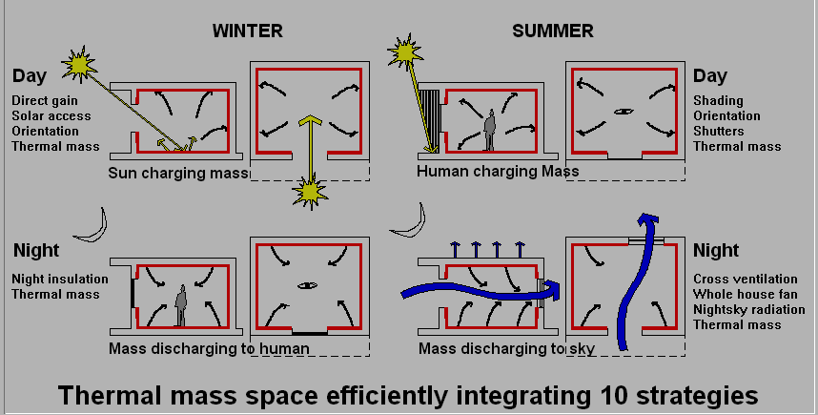
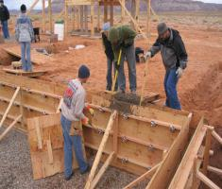
design strategies
Courtesy: DesignBLUFF
design strategies to consider for thermal mass
Courtesy: DesignBLUFF
thermal mass

Slide 28
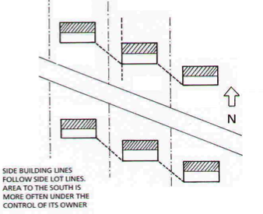
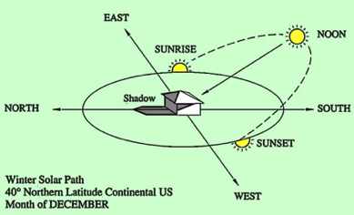
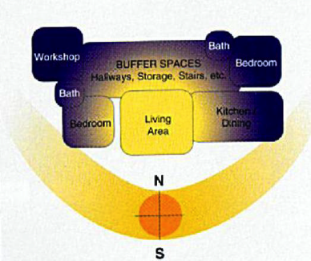
design strategies
summer
winter
Orient housing to south, rather than streets
Rendering: Cliff Johns- Solar angle study 2011
building orientation

Slide 29
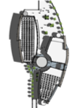







design strategies
SUMMER
SOLISTICE
June 21 @ 9AM
June 21 @ 1PM
June 21 @ 4PM
Rendering: Cliff Johns – Sunset Knowledge Center Dec 2011 Design
WINTER
SOLISTICE
Dec 21 @ 9AM
Dec 21 @ 1PM
Dec 21 @ 4PM
Rendering: Cliff Johns – Sunset Knowledge Center Dec 2011 Design
shade studies

Slide 30

design strategies
Rooftop PV panels
Rooftop PV panels with greenroof
Rendering: Cliff Johns – Sunset Knowledge Center Dec 2011 Design
Rendering: Cliff Johns – Leading Edge Design Competition- April 2012
passive solar

Slide 31



design strategies
Rendering by: Cliff Johns – Leading Edge Competition 2012
Courtesy: I’-Sah-Din-Di Housing Development- Mescalero, NM
Rendering by: Cliff Johns – Leading Edge Competition 2012
shading

Slide 32





design strategies
Sketches by: Cliff Johns – Natural Ventilation: When Buildings Meet Plaza- 2011
Rendering by: Cliff Johns – Sunset Knowledge Center Sustainable Community- Tucson AZ. 2011
natural ventilation

Slide 33
in summary
energy design strategies
thermal mass
building orientation
passive solar
shading
natural ventilation
Reduction of Energy consumption
Energy cost savings
Thermal comfort
Reduction of (CO₂) Greenhouse gas
emissions
Integration into natural environment

Slide 34
research
Energy Retrofit Design Approach

Slide 35




HED – House Energy Doctor
Gottfried residence: energy efficiency analysis
The “House Energy Doctor” is the ongoing community outreach arm of the post professional Master of Science in Architecture (MS-ARCH) graduate degree program at the University of Arizona.
Established in 1986 this program has been serving the community for twenty-five years
The students utilize advanced technological equipment to analyze existing residences for their energy performance in an effort to educate owners, and the community at large, on how to conserve energy in their own homes
Computer simulations are then developed, using Energy-10 software, to study a variety of energy and cost saving strategies for the homeowner.
building retrofits for existing homes

Slide 36

HED – House Energy Doctor University of Arizona
research
building retrofits for existing homes Gottfried Residence- Tucson AZ

Slide 37





HED – House Energy Doctor University of Arizona
research
Leaks through the masonry brick
walls
Basic infiltration and leaks through windows and doors
building retrofits for existing homes Gottfried Residence- Tucson AZ

Slide 38


HED – House Energy Doctor University of Arizona
research
Exposed rooftop ducts and HVAC unit.
Direct heat gain from sun exposure
building retrofits for existing homes Gottfried Residence- Tucson AZ

Slide 39

HED – House Energy Doctor University of Arizona
research

Slide 40

HED – House Energy Doctor University of Arizona
research
Energy-10 Calcs
building retrofits for existing homes Gottfried Residence- Tucson AZ

Slide 41

HED – House Energy Doctor University of Arizona
research
Energy-10 Calcs
building retrofits for existing homes Gottfried Residence- Tucson AZ

Slide 42

HED – House Energy Doctor University of Arizona
research
Achieving Net-Zero
building retrofits for existing homes Gottfried Residence- Tucson AZ

Slide 43
HED – House Energy Doctor University of Arizona
research
Net-Zero
LEED Platinum
Gottfried
Residence
Code compliance
ASHRAE 90.1- 2007
Before
(baseline)
Pre-Code
building retrofits for existing homes Gottfried Residence- Tucson AZ

Slide 44


HED – House Energy Doctor University of Arizona
summary
Gottfried Residence | Energy Consumption (kBtu/ft²) | Energy Costs $ (Per Year) | Energy Costs $ (Per Month) | CO₂ Emissions (tons)
Baseline (Before) | 64,231 | $1854 / year | $155 / mo. | 20,715 lbs/CO₂ = 10 tons
Combined Strategies | 42,334 | $1065 / year | $89 / mo. | 11,975 lbs/CO₂ = 5 tons
Savings | 66% | 57% | 57% | 58%
building retrofits for existing homes Gottfried Residence- Tucson AZ

Slide 45


t h a n k . y o u
Contact information:
Cliff Johns
cpjohns@email.arizona.edu
http://houseenergydoctor.arizona.edu

