Slide 1
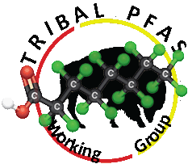

PFAS
in
Indian Country
at a
Glance

Slide 2
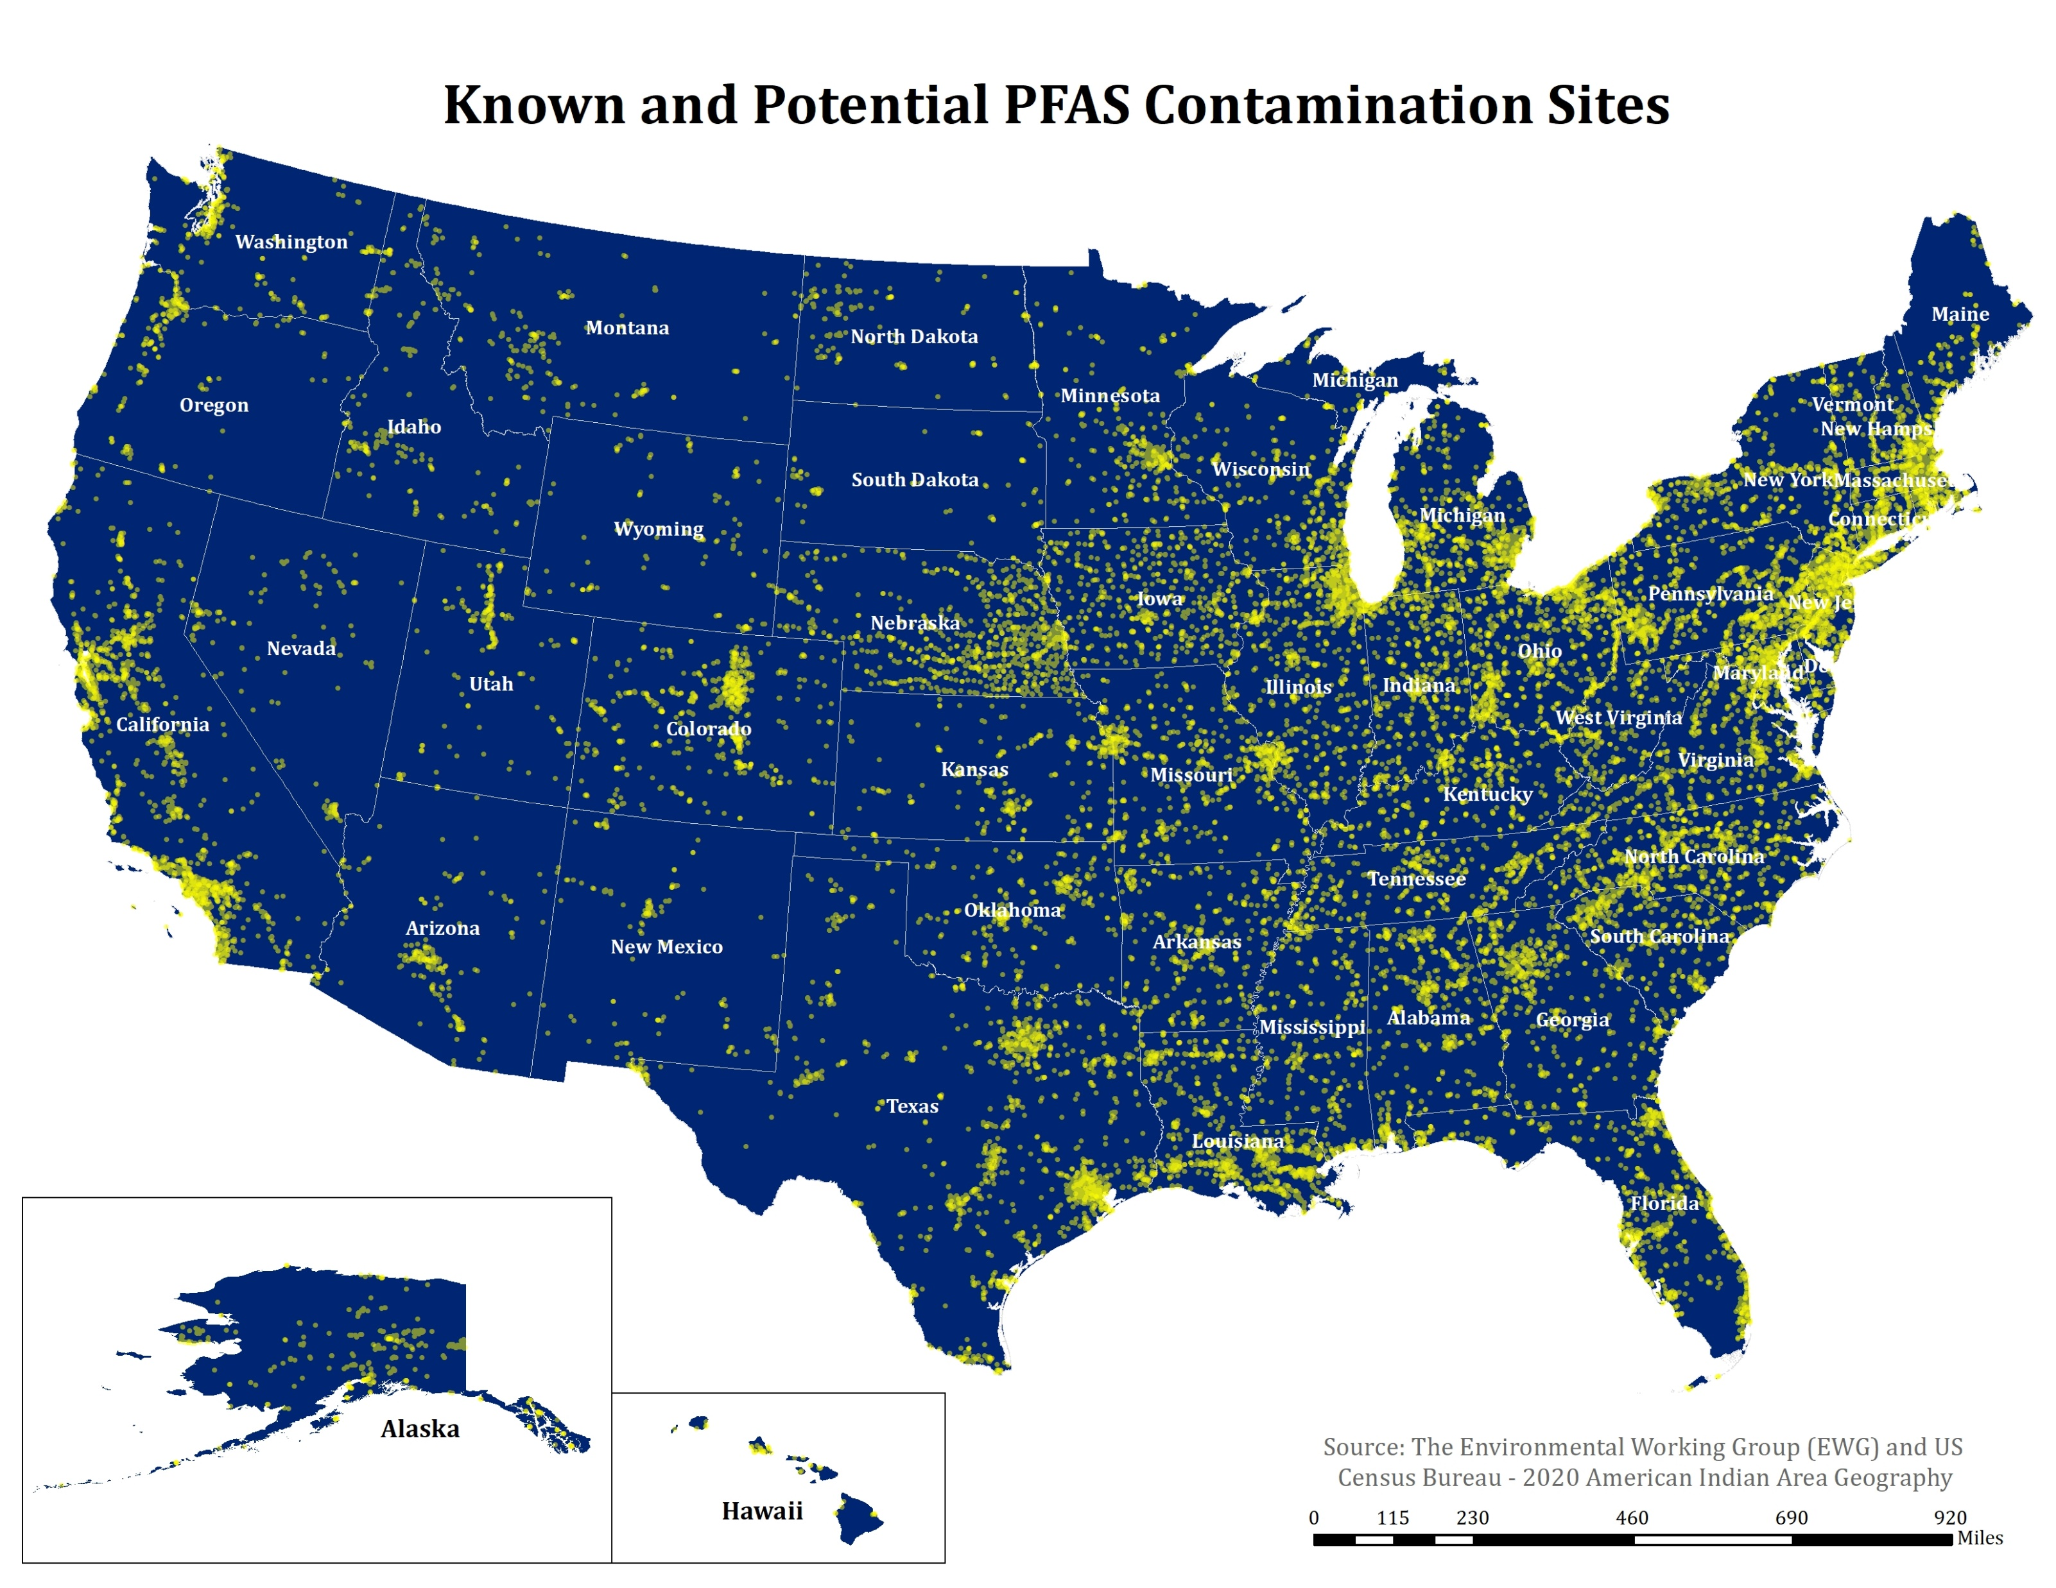

Slide 3
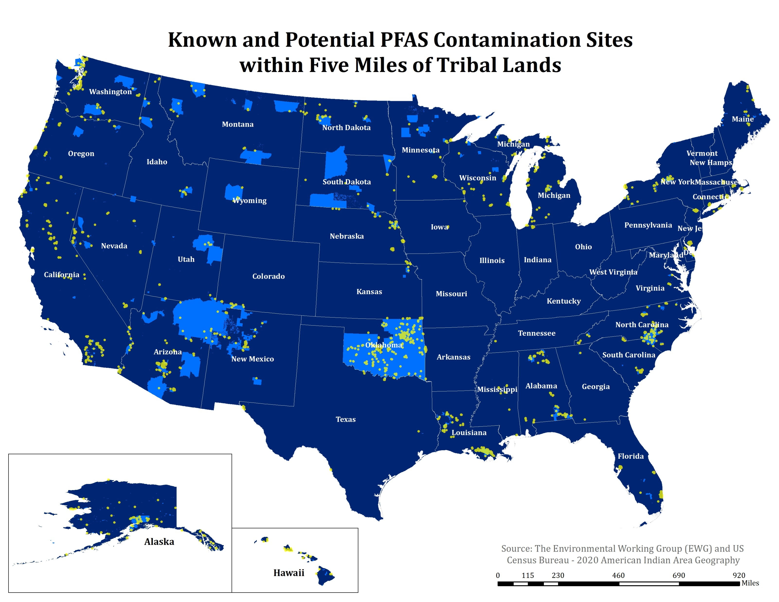

Slide 4
Known and Potential PFAS Contamination Sites Within Five Miles of Tribal Lands
Contamination Categories
Source: The Environmental Working Group (EWG) and US Census Bureau – 2020 American Indian Geography

Slide 5
Known and Potential PFAS Contamination Sites Within Five Miles of Tribal Lands
Top 20 States
Source: The Environmental Working Group (EWG) and US Census Bureau – 2020 American Indian Geography

Slide 6
Known and Potential PFAS Contamination Sites Within Five Miles of Tribal Lands
Top 20 Counties
Source: The Environmental Working Group (EWG) and US Census Bureau – 2020 American Indian Geography

Slide 7
Known and Potential PFAS Contamination Sites Within Five Miles of Tribal Lands
Top 20 Tribal Lands
Source: The Environmental Working Group (EWG) and US Census Bureau – 2020 American Indian Geography

